Slide 1
Computer Science
Shortest Path Algorithms
Samuel Lukas

Slide 2
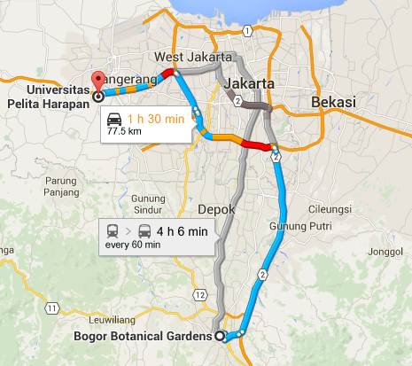
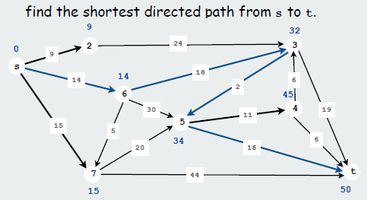
Introduction
The shortest path problem is the problem of finding a path between two vertices (or nodes) in a graph such that the sum of the weights of its constituent edges is minimized.

Slide 3
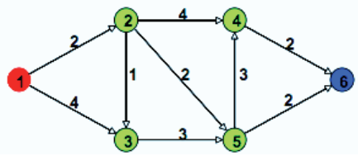
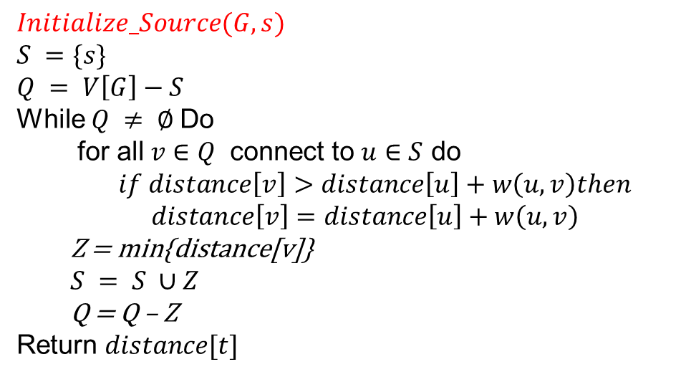
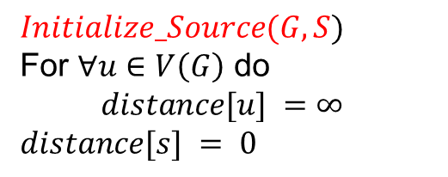
Dijkstra Algorithm
$Initialize_Source(G,s)$
$S =\{s\}$
$$Q = V\left[G\right]−S$$
While $Q ≠ ∅$Do
for all $v∈Q$ connect to $u∈S$ do
$if distance\left[v\right]>distance\left[u\right]+w\left(u,v\right)then$
$distance\left[v\right]=distance\left[u\right]+w\left(u,v\right)$
Z = min{distance[v]}
$S = S ∪Z$
Q = Q – Z
Return $distance[t]$
$$Initialize_Source(G,S)$$
For $∀u∈V\left(G\right)$ do
$distance[u] =∞$
$$distance[s] = 0$$

Slide 4
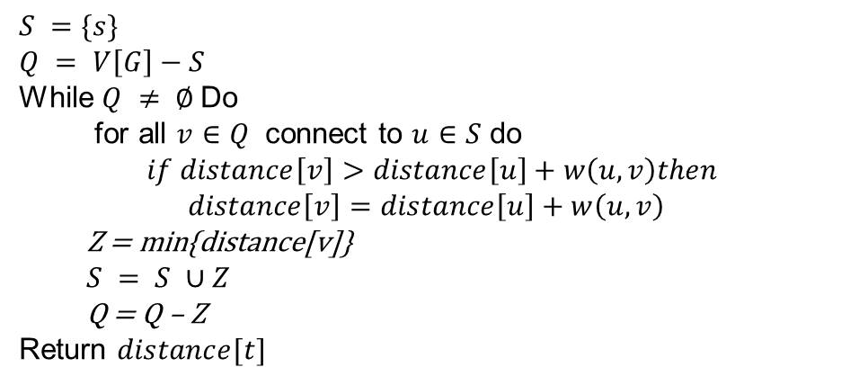


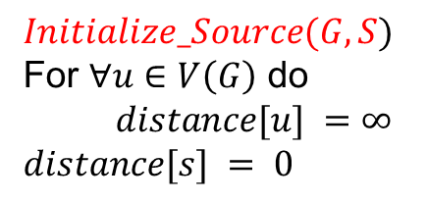











Dijkstra Algorithm Example
$$Initialize_Source(G,S)$$
For $∀u∈V\left(G\right)$ do
$distance[u] =∞$
$$distance[s] = 0$$
$$∞$$
$$∞$$
2
4
4
2
2
1
2
3
1
6
$$∞$$
0
$$S =\{1\}$$
$S =\{s\}$
$$Q = V\left[G\right]−S$$
While $Q ≠ ∅$Do
for all $v∈Q$ connect to $u∈S$ do
$if distance\left[v\right]>distance\left[u\right]+w\left(u,v\right)then$
$distance\left[v\right]=distance\left[u\right]+w\left(u,v\right)$
Z = min{distance[v]}
$S = S ∪Z$
Q = Q – Z
Return $distance[t]$
2
4
3
5
$$Q =\{2,3,4,5,6\}$$
$$∞$$
3
$$V =\{2,3\}$$
$$∞$$
$$distance\left[2\right]=2$$
$$distance\left[3\right]=4$$
$$Z =\{2\}$$
$$S =\{1,2\}$$
$$Q =\{3,4,5,6\}$$

Slide 5





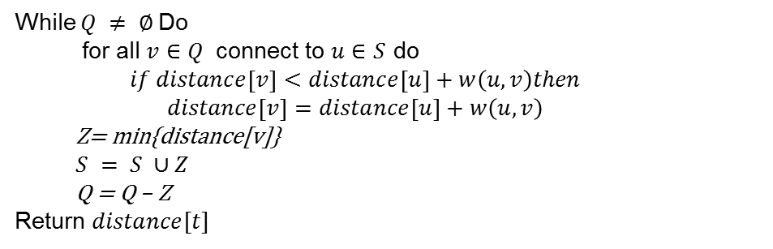





Dijkstra Algorithm Example
2
$$∞$$
2
4
4
2
2
1
2
3
1
6
$$∞$$
0
$$S =\{1,2\}$$
4
2
3
5
$$Q =\{3,4,5,6\}$$
3
$$V =\{3,4,5\}$$
While $Q ≠ ∅$Do
for all $v∈Q$ connect to $u∈S$ do
$if distance\left[v\right]<distance\left[u\right]+w\left(u,v\right)then$
$distance\left[v\right]=distance\left[u\right]+w\left(u,v\right)$
Z= min{distance[v]}
$S = S ∪Z$
Q = Q – Z
Return $distance[t]$
$\sim →$4
$$∞$$
$$distance\left[3\right]=3$$
$$distance\left[4\right]=6$$
$$distance\left[5\right]=4$$
$$Z =\{3\}$$
$$S =\{1,2,3\}$$
$$Q =\{4,5,6\}$$

Slide 6











Dijkstra Algorithm Example
2
$\sim →$6
2
4
4
2
2
1
2
3
1
6
$$∞$$
0
$$S =\{1,2,3\}$$
4
2
3
5
$$Q =\{4,5,6\}$$
3
$$V =\{4,5\}$$
$$4→3$$
While $Q ≠ ∅$Do
for all $v∈Q$ connect to $u∈S$ do
$if distance\left[v\right]<distance\left[u\right]+w\left(u,v\right)then$
$distance\left[v\right]=distance\left[u\right]+w\left(u,v\right)$
Z= min{distance[v]}
$S = S ∪Z$
Q = Q – Z
Return $distance[t]$
$\sim →$4
$$distance\left[4\right]=6$$
$$distance\left[5\right]=4$$
$$Z =\{5\}$$
$$S =\{1,2,3,5\}$$
$$Q =\{4,6\}$$

Slide 7




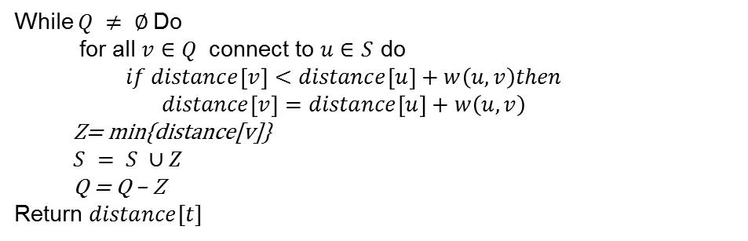






Dijkstra Algorithm Example
2
$6→$ 6
2
4
4
2
2
1
2
3
1
6
$$∞$$
0
$$S =\{1,2,3,5\}$$
4
2
3
5
$$Q =\{4, 6\}$$
3
$$V =\{4,6\}$$
$$3$$
While $Q ≠ ∅$Do
for all $v∈Q$ connect to $u∈S$ do
$if distance\left[v\right]<distance\left[u\right]+w\left(u,v\right)then$
$distance\left[v\right]=distance\left[u\right]+w\left(u,v\right)$
Z= min{distance[v]}
$S = S ∪Z$
Q = Q – Z
Return $distance[t]$
4
$$distance\left[4\right]=6$$
$$distance\left[6\right]=6$$
$$Z =\{4\}$$
$$S =\{1,2,3,4,5\}$$
$$Q =\{6\}$$

Slide 8










Dijkstra Algorithm Example
2
6
2
4
4
2
2
1
2
3
1
6
$$∞$$
$$6$$
0
$$S =\{1,2,3,4,5\}$$
4
2
3
5
$$Q =\{6\}$$
3
$$V =\{6\}$$
While $Q ≠ ∅$Do
for all $v∈Q$ connect to $u∈S$ do
$if distance\left[v\right]<distance\left[u\right]+w\left(u,v\right)then$
$distance\left[v\right]=distance\left[u\right]+w\left(u,v\right)$
Z= min{distance[v]}
$S = S ∪Z$
Q = Q – Z
Return $distance[t]$
$$3$$
4
$$distance\left[6\right]=6$$
$$Z =\{6\}$$
$$S =\{1,2,3,4,5,6\}$$
$$Q =\{ \}$$

Slide 9
Exercise 01
7
24
2
18
9
6
2
3
19
14
30
6
11
1
5
6
5
20
16
15
8
44
4
Find the minimum path from 1 to 8

Slide 10
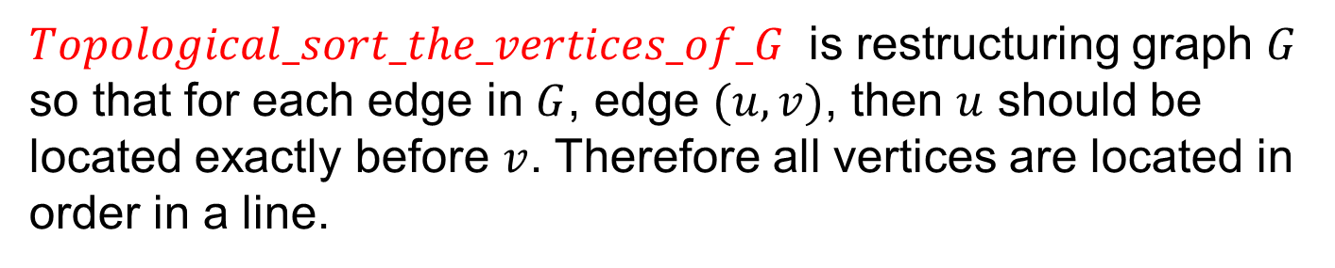
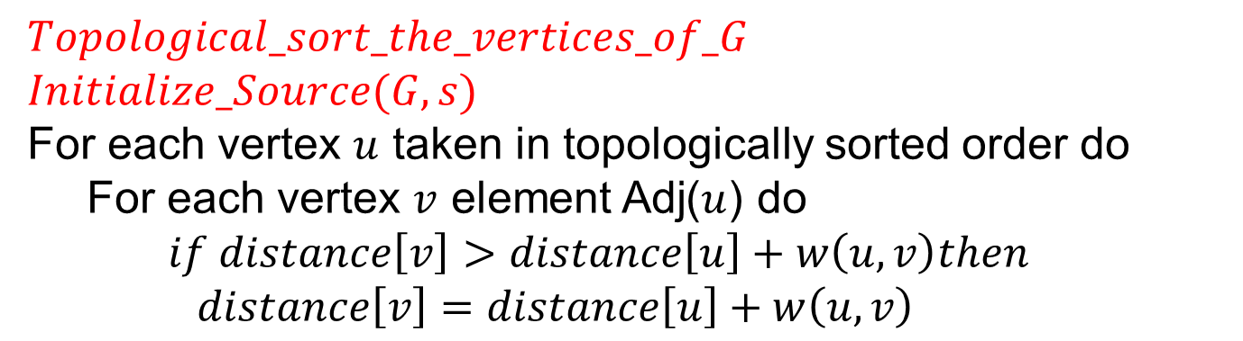
DAG Algorithm in shortest Path
$$Topological_sort_the_vertices_of_G$$
$Initialize_Source(G,s)$
For each vertex $u$ taken in topologically sorted order do
For each vertex $v$ element Adj($u$) do
$if distance\left[v\right]>distance\left[u\right]+w\left(u,v\right)then$
$distance\left[v\right]=distance\left[u\right]+w\left(u,v\right)$
$Topological_sort_the_vertices_of_G$ is restructuring graph $G$ so that for each edge in $G$, edge $(u,v)$, then $u$ should be located exactly before $v$. Therefore all vertices are located in order in a line.

Slide 11
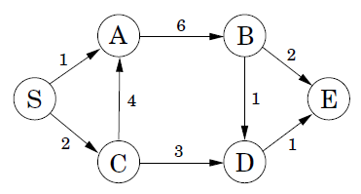
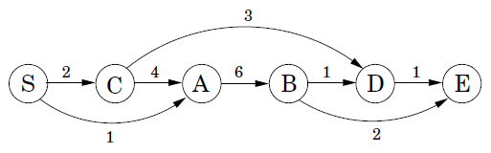
Example Directed Acyclic Graph
Find the shortest path from s
$$Distance\left(D\right)=min⁡\{Distance\left(B\right)+1,Distance\left(C\right)+3\}$$

Slide 12
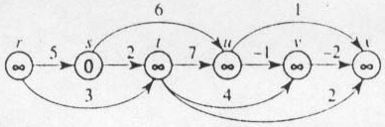
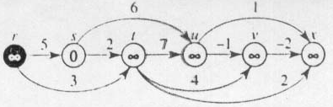
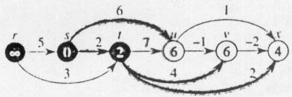
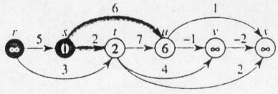
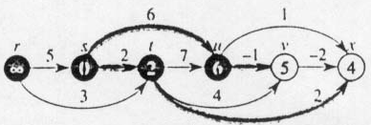
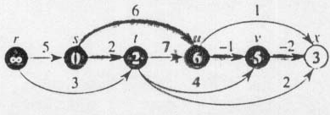
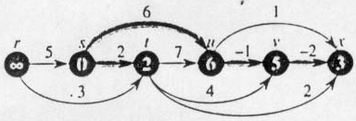
DAG Algorithm in shortest Path Example

Slide 13
Exercise 02
6
U
S
5
1
7
-1
R
2
3
V
4
-2
W
2
T
Find the shortest path from s

